Slide 1


Slide 2
INTER-THREAD CACHE BENEFITS TO HARD REAL-TIME SCHEDULING
Prospectus Defense by Corey Tessler (corey.tessler@wayne.edu)
Advised by Professor Nathan Fisher (fishern@wayne.edu)
Notes:
Thank you for being here, my name is Corey Tessler, my advisor is Nathan Fisher. Today, I’ll be presenting our ongoing work of bringing inter-thread cache benefits to hard real-time scheduling.

Slide 3


Hard Real-Time Systems
Differ from a non-real-time systems by two significant aspects:
Results must be logically and temporally correct, where results must arrive on time (neither early nor late).
A logical or temporal error is catastrophic, where safety or property is put at risk.
CPU
$$θ$$
Notes:
The context of our work is within Hard Real-Time Systems.
There are two aspects of hard real-time computational systems that differentiate them from non-real-time systems.
First, for a hard real-time system, every operation must produce both a correct logical result and a temporally correct result. A non-real-time system does not, necessarily, have a temporal requirement.
Second, for a hard real-time system a failure to produce a logically or temporally correct result is a catastrophic failure, potentially damaging equipment or endangering personal safety.
An example of a hard real-time system that I like to use is a pace maker. A small device, implanted within a patient to induce heart beats. CLICK
A pace maker must always fire at the proper time, never too late, never too early. If it did either of these things the results could be fatal. Before implanting a pace-maker in a patient, we want a formal verification of its behavior.

Slide 4
Classical Schedulability Analysis
Programmer’s
View
Analytical
View
Classical†‡ works assume each task contains exactly one thread of execution.
Synthesize
†C. L. Liu and J. W. Layland, “Scheduling algorithms for multiprogramming in a hard-real-time environment”, J. ACM, 1973.
‡J. Sun, N. Guan, Y. Wang, Q. Deng, P. Zeng, and W. Yi, “Feasibility of fork-join real-time task graph models: Hardness and algorithms”, ACM Trans. Embed. Comput. Syst., Feb. 2016
Task
Thread
Notes:
Schedulability analysis provides that formal verification method. Guaranteeing hard real-time system will always be temporally correct. It tells us whether or not each of the system’s tasks will always complete on time.
Classical models of hard real-time systems assume each task has exactly one thread of execution. Correspondingly, the analytical techniques depend on the single threaded assumption to determine if the system is schedulable.
Modern task sets may violate the single threaded assumption, releasing multiple threads of execution with each job. (do not click)
To perform a schedulability analysis under the classical model, each thread of a multi-threaded task is synthesized into an independent single threaded task. (do not click)
Schedulability analysis of the single threaded task set determines if the system will meet its temporal requirements, where each task contributes independently to the overall demand.

Slide 5
Inter-Thread Cache Benefit
Setting
Program
Cache
Thread 1
Addr.
Instruction
Thread 2
Set
Addr.
Multi-threaded task
Single processor
Instruction cache
8be8
push {r4, r5, lr}
5
8be8
8bec
sub sp, sp, #20
6
8bec
8bf0
mov r3, #8
7
8bf0
8bf4
str r3,[sp, #8]
8
8bf4
8bf8
b 8c9c
9
8bf8
Independent Analysis
Execution Time
Inter Thread Cache Benefit
Notes:
However, threads of the same task are not independent. Threads share resources and the shared resource we are interested in is cache memory. In contrast to other approaches we perceive caches positively, finding they can provide a benefit to run-time performance and reduce the worst-case execution time of multi-threaded tasks.
For example CLICK
Consider a two-threaded-task that is comprised of the following instructions, threads execute on a shared single-processor that provides an instruction cache.
For the first thread, the first instruction will miss the cache CLICK
Because it is a miss, the instruction’s execution time will be increased by the time it takes to move the instruction into the cache before execution. CLICK
Similarly, the second instruction misses the cache, forcing it to be loaded into the cache before execution. CLICK
The same is true for the remaining instructions of the first thread.
Animation finishes CLICK
If we take a moment to look at these instructions, there are no branches or loops. The execution time modelled at the bottom of the slide is the same value an independent analysis would calculate for the task’s worst-case execution time.
When using this worst case execution time for the second thread as a synthetic task, classical analysis would treat the second thread as an independent task. Treating them independently, the worst case execution time to complete both tasks would simply be double the first value. CLICK
However, the first thread has populated the cache with all of the instructions the second thread will execute. So, the first instruction of the second thread results in a cache hit with a shorter execution. CLICK
CLICK Since there are no branches or loops, all instructions hit the cache without the need to load them before execution.
Animation finishes CLICK
It is this reduction of run-time and worst-case execution time values that we call the inter-thread cache benefit.

Slide 6
Related (Independent) Works
Models with Separate WCET
Base: Liu, Layland. ACM 1973
Fork-Join: Sun et al. ACM 2016
Negative Cache Interactions
Concurrent: Sunhendra et al. RTSS 2009
Concurrent: Mittermayr, Blieberg. OASIcs 2012
CRPD: Lee et al. IEEE Trans. on Comput. 1998
CRPD: Altmeyer, Burguiere. Journ. of Syst. Arch. 2011
CRPD: Cazora et al. ACM 2013
Limiting Negativity of Caches
Calandrino. ECRTS 2008
Schoeberl et al. SEUS 2009
Pellizzoni et al. RTAS 2011
Bak et al. ECRTS 2012
Ward et al. ECRTS 2013
Alhamad, Pelizzoni. DATE 2014
Positive Perspective
Calandrino. PhD UNC Chapel Hill 2009.
Rashid et al. ECRTS 2016
Rashid et al. RTSS 2017
Notes:
Our work is the first to quantify the inter-thread cache benefit for hard real-time systems. However, the impact of caches on worst-case execution time and schedulability is well studied, and our work draws heavily on the concepts developed for cache related preemption delay – abbreviated CRPD. However, previous works treat caches almost exclusively as detractors to schedulability analysis in part due to their independent treatment of threads.
For multi-threaded models such as fork-join and concurrent program analysis, threads and synthetic tasks contribute their demand without consideration of one another. This leads to a negative treatment of caches for schedulability as well as cache related preemption delay analysis. While there are many refinements to CRPD through improved analysis and scheduling techniques, these are only refinements which limit the negative impacts of caches without consideration for the possible positive benefits.
There are few works we are aware of that take a positive perspective of caches. Calindrino’s PhD dissertation at Chapel Hill, limits the “cache spread” of threads. However, there is only an empirical evaluation and no analytical component. Rashid’s work takes a truly positive approach, accounting for the benefit of persistent cache blocks – those blocks that remain in the cache after a job has terminated and are reused when the next job is released. While positive, Rashid’s works address an orthogonal benefit to our own, and is limited to single threaded tasks without consideration for scheduling techniques.

Slide 7
Thesis (abridged)
Scheduling individual threads of a multi-threaded task in a cache cognizant manner improves system schedulability through predictable and quantifiable inter-thread cache benefits.
Inter-thread Cache Benefit
Lower WCET
Improved Schedulability
Notes:
Independent treatment of tasks from the classical perspective creates an opportunity for the introduction of an integrated, positive one. Which leads to the central thesis of our work.
CLICK
Read the thesis

Slide 8
Contributions in Support
General
Inter-thread cache benefit
Novel model of multi-threaded tasks.
Concepts:
WCETO: worst-case execution time and cache overhead.
CFR: Conflict Free Region.
CFRG: Conflict Free Region Graph.
BUNDLE
Cache cognizant thread-level scheduling algorithm for a single multi-threaded task.
WCETO method for BUNDLE.
Simulated analysis of BUNDLE.
BUNDLEP
Cache cognizant priority based thread-level scheduling algorithm for a single multi-threaded task.
WCEO method for BUNDLEP.
Practical WCETO analysis for BUNDLEP.
Simulation and evaluation platform.
XFLICT interrupt hardware proposal.
Notes:
Currently, we have two integrated scheduling approaches that support our thesis: BUNDLE and BUNDLEP.
They share common concepts introduced in our work. Particularly
the definition and quantification of the inter-thread cache benefit
a novel model of multi-threaded task systems
the concept of worst case execution time combined with cache overhead
modification of a threads control flow graph into conflict free regions and conflict free region graphs.
CLICK BUNDLE is a thread-level scheduler with accompanying WCETO analysis.
CLICK BUNDLEP is a priority based thread-level scheduler with WCETO analysis, practical WCETO calculation for real tasks, a reusable and extensible simulation and evaluation platform, which demonstrates the success of our proposed hardware conflict interrupt mechanism.

Slide 9
Independent (Classical) Approach
Scheduling Algorithm
WCET Analysis
Preemption Delay Analysis (CRPD)
Schedulability Analysis
Notes:
To differentiate our approach from existing ones, we present the classical approaches in the following manner. Where scheduling algorithms, WCETO analysis, schedulability analysis, and preemption delay analysis are independent.

Slide 10
Integrated Approach
Task Analysis
Scheduling Algorithm
WCET Analysis
Preemption Delay Analysis (CRPD)
BUNDLE
BUNDLEP
v
Schedulability Analysis
Notes:
Our integrated approach shares information between the disciplines.
CLICK Currently, our approaches are limited to a single multi-threaded task, which limits our contributions to single task analysis.
CLICK We will begin by focusing on BUNDLE’s approach, and the later the extensions that contribute BUNDLEP.

Slide 11
Integrated Approach
Task Analysis
Conflict Free Region Graph Creation
BUNDLE
Scheduling Algorithm
WCETO: Worse Case Execution Time and Cache Overhead
Notes:
For single task analysis, the initial step is to create a conflict free region graph.
The conflict free region graph is provided to the scheduling algorithm as input for scheduling decisions.
It is also provided to worst-case execution time analysis to determine a bound on the execution time for a single job released with multiple threads.

Slide 12

From CFG to CFRG: Control Flow Graph, CFG
CFG: Graph of possible execution paths through a thread.
Nodes: basic blocks (typically).
Edges: possible logical control paths.
Entry node
$$h$$
Notes:
Task analysis begins with the control flow graph of a thread.
A CFG is an abstract representation of the threads executable object. It is comprised of nodes and edges.
A node in the graph, represents a unit of execution. Typically a basic block, in all of our examples a node of the control flow graph is a single instruction.
An edge in the graph represents potential logical shifts that can occur during the execution of the object.
Control flow graphs have an additional property, that there is an entry node which is weakly connected to all other nodes within it.

Slide 13
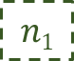
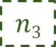
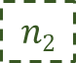
From CFG to CFRG: Conflict Free Region, CFR
CFR: A weakly connected sub-graph of a thread’s control flow graph, where the execution of any instruction cannot evict any other from the cache.
Control Flow Graph
$$n1$$
1
2
4
3
CFRs
$$n2$$
4
2
$$n3$$
4
2
Cache Block
Notes:
For task analysis, the control flow graph of a thread is converted into conflict free regions.
A conflict free region, is a subgraph of the control flow graph where the execution of any two instructions will not evict one another in the cache. Additionally, each conflict free region is itself a control flow graph with an entry node weakly connected to all others within it.
CLICK In the example, each node of the control flow graph CLICK is labeled with the cache block it maps to. CLICK
Taking this example, and separating nodes by their conflicts and putting them into individual control flow graphs, we produce three conflict free regions.

Slide 14
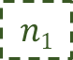
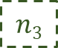
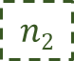
CFG to CFRG: Conflict Free Region Graph
CFRG: A complete control flow graph of a thread where each node is a CFR.
$$n1$$
1
n₁
n₃
3
2
4
CFRs
$$n2$$
4
2
$$n3$$
4
2
n₂
CFRG
Notes:
Conflict free regions become elements of conflict free region graphs. Please excuse the shorthand that I will use throughout the rest of the presentation, these terms can be a mouthful. I may refer to conflict free regions simply as “regions“ and conflict free region graphs as “region graphs”.
A conflict free region graph compiles the individual conflict free regions of a thread into a control flow graph spanning the entire thread.
CLICK Nodes of the conflict free region graph are conflict free regions.
Edges are possible execution paths from one conflict free region to another.
Since the conflict free region graph is a control flow graph, there is an entry node weakly connected to all other nodes, this represents all possible paths of execution through the threads object.

Slide 15
BUNDLE: CFR Structures, Linear
For BUNDLE WCETO analysis, individual CFRs must conform to one of the predefined structures:
Linear
Branching
Looping
Linear CFR
1
1
2
4
3
2
Notes:
In BUNDLE there is a requirement that each of the CFRs within the CFRG follow one of the three predefined structures. The reason for this, is that each structure is categorized with a different WCET and cache overhead function.
The first, and simplest structure is Linear. A linear structure is a conflict free region that has no branches, every instruction has in degree and out degree of one.

Slide 16
BUNDLE: CFR Structures, Branching
For BUNDLE WCETO analysis, individual CFRs must conform to one of the predefined structures:
Linear
Branching
Looping
Branching CFR
1
1
2
4
3
3
5
5
Notes:
A branching CFR includes nodes with in degree and out degree that may be greater than one. However, a branching structure may not contain any cycles.

Slide 17
BUNDLE: CFR Structures, Looping
For BUNDLE WCETO analysis, individual CFRs must conform to one of the predefined structures:
Linear
Branching
Looping
Looping CFR
1
1
3
4
3
2
5
Notes:
Looping structures have strict requirements on entry and exit paths.
Each loop structure must have a single entry instruction which is the loop head.
In addition, this loop head must be the sole exit point for any iteration of the loop.
Within a looping structure, there may be additional linear, branching, or looping structures.
However, embedded looping structures must follow the same structure with a single entry and exit point which is the loop head.

Slide 18









BUNDLE: Thread-Level Scheduling Algorithm
BUNDLE’s scheduling algorithm operates on the CFRG of a thread. Associating with each CFR a thread container called a bundle.
$$n1$$
$$n2$$
$$n3$$
Threads
$$n4$$
$$n5$$
$$n6$$
$$n7$$
Bundles
$$n8$$
$$n9$$
Notes:
BUNDLE bases its thread level scheduling decisions on the conflict free region graph.
CLICK It does so by associating with each region a container we call a bundle.
CLICK A bundle holds threads which are waiting to execute over the associated region.

Slide 19
BUNDLE: Thread-Level Scheduling Algorithm
At run-time, only one bundle may be active.
Only threads of the active bundle execute until they attempt to leave it.
After blocking, threads enter a new inactive bundle.
$$n1$$
$$n2$$
$$n3$$
$$n4$$
$$n5$$
$$n6$$
$$n7$$
$$n8$$
$$n9$$
Active
Inactive
Notes:
CLICK At run time, only one bundle may be active. CLICK

Slide 20
BUNDLE: Thread-Level Scheduling Algorithm
At run-time, only one bundle may be active.
Only threads of the active bundle execute until they attempt to leave it.
After blocking, threads enter a new inactive bundle.
$$n1$$
$$n2$$
$$n3$$
$$n4$$
$$n5$$
$$n6$$
$$n7$$
$$n8$$
$$n9$$
Active
Inactive
Notes:
Only threads of the active bundle are allowed to execute on the shared processor
When a thread of the active bundle attempts to leave the active bundle by executing an instruction of an inactive conflict free region, the thread is blocked and placed in the new inactive bundle.

Slide 21
BUNDLE: Thread-Level Scheduling Algorithm
Selecting which bundle will become active is arbitrary.
Repeating the process until all threads complete execution.
$$n1$$
$$n2$$
$$n3$$
n₄
$$n5$$
$$n6$$
$$n7$$
$$n8$$
$$n9$$
Active
Inactive
Notes:
The selection of which bundle will become active is arbitrary. CLICK

Slide 22
BUNDLE: Thread-Level Scheduling Algorithm
Selecting which bundle will become active is arbitrary.
Repeating the process until all threads complete execution.
$$n1$$
$$n2$$
$$n3$$
$$n4$$
$$n5$$
$$n6$$
$$n7$$
$$n8$$
$$n9$$
Active
Inactive
Notes:
The process of selecting an active bundle, executing threads until they all leave the bundle CLICK

Slide 23
BUNDLE: Thread-Level Scheduling Algorithm
Selecting which bundle will become active is arbitrary.
Repeating the process until all threads complete execution.
$$n1$$
$$n2$$
$$n3$$
$$n4$$
$$n5$$
$$n6$$
$$n7$$
$$n8$$
$$n9$$
Active
Inactive
Notes:
and selecting a new active bundle continues until all threads terminate. CLICK

Slide 24
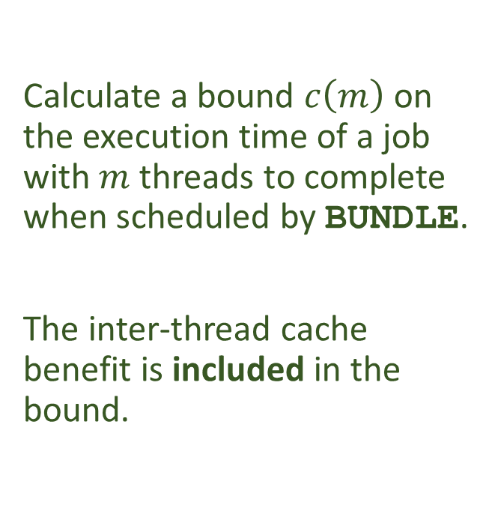
BUNDLE WCETO: WCET & Cache Overhead
Calculate a bound $c\left(m\right)$ on the execution time of a job with $m$ threads to complete when scheduled by BUNDLE.
The inter-thread cache benefit is included in the bound.
$$n1$$
$$n2$$
$$n3$$
$$n4$$
$$n5$$
$$n6$$
$$n7$$
$$n8$$
$$n9$$
Notes:
Scheduling threads by their bundle allows the inter-thread cache benefit to be quantified and incorporated into WCET analysis.
The goal of WCETO analysis is to provide a bound for C for M threads to complete when released with each job

Slide 25
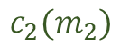
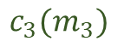
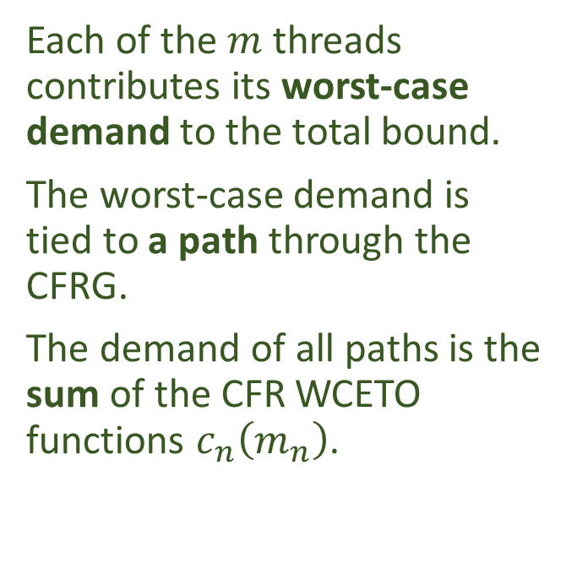
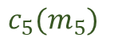
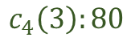
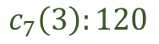
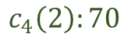
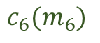
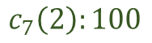
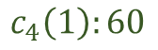
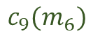
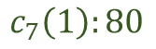
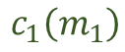
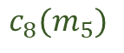
BUNDLE WCETO: WCET & Cache Overhead
Each of the $m$ threads contributes its worst-case demand to the total bound.
The worst-case demand is tied to a path through the CFRG.
The demand of all paths is the sum of the CFR WCETO functions $c_{n}\left(m_{n}\right)$.
$$n1$$
$$n2$$
$$n3$$
$$c_{1}\left(m_{1}\right)$$
$$c_{2}(m_{2})$$
$$c_{3}(m_{3})$$
$$n4$$
$$n5$$
$$n6$$
$$n7$$
$$c_{4}\left(1\right):60$$
$$c_{5}(m_{5})$$
$$c_{6}(m_{6})$$
$$c_{7}\left(1\right):80$$
$$c_{4}\left(2\right):70$$
$$c_{7}\left(2\right):100$$
$$c_{4}\left(3\right):80$$
$$c_{8}(m_{5})$$
$$c_{9}(m_{6})$$
$$c_{7}\left(3\right):120$$
$$n8$$
$$n9$$
Notes:
To compute C of M, a cost function is associated with each region and depends on the structure of the region. Each cost function has a single parameter which is the number of threads assigned to that region.
Using the cost functions, M worst-case execution time paths are constructed over the conflict free region graph.
Finally, the sum of cost functions yields the bound C of M.

Slide 26
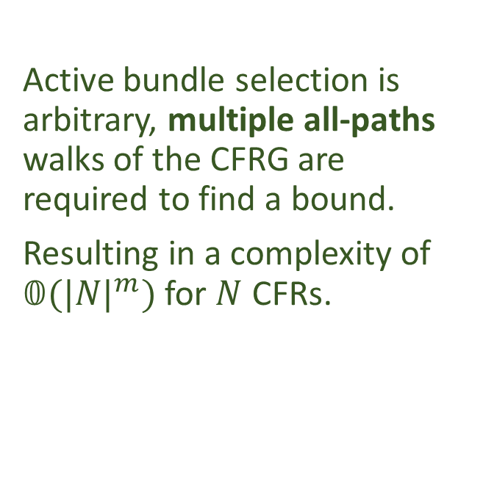
BUNDLE WCETO: WCET & Cache Overhead
Active bundle selection is arbitrary, multiple all-paths walks of the CFRG are required to find a bound.
Resulting in a complexity of $𝟘{(|N|}^{m})$ for $N$ CFRs.
$$n1$$
$$n2$$
$$n3$$
$$n4$$
$$n5$$
$$n6$$
$$n7$$
$$n8$$
$$n9$$
Notes:
As a consequence of arbitrarily selecting which bundle becomes active, when calculating the M worst case paths, multiple all-paths walks of the CFRG are required.
Potential Question: Why not use the individual worst path values
Answer: That would be pessimistic and my answer is exact.

Slide 27
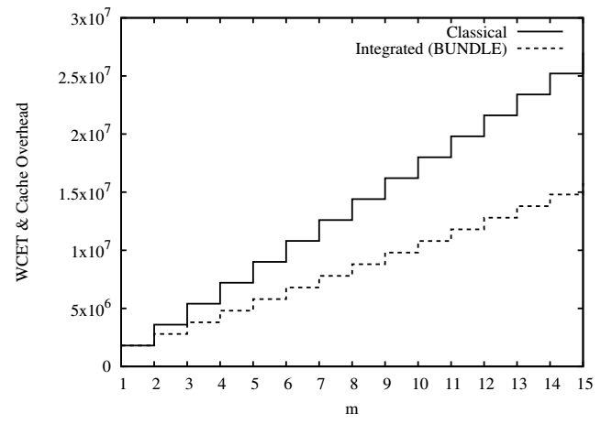
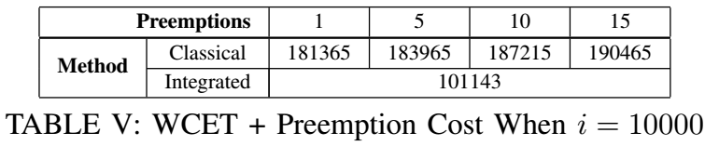
BUNDLE Analytical Evaluation
(Assuming context switches take no time)
WCET vs WCETO
Preemption Delay Comparison
R. Arnold, F. Mueller, D. Whalley, and M. Harmon. Bounding worst-case instruction cache performance. RTSS 1994
F. Mueller. Static Cache Simulation and Its Applications. Ph.d. dissertation, Florida State University, 1995
W. Lunniss, S. Altmeyer, C. Maiza, and R. I. Davis. Integrating cache related pre-emption delay analysis into edf scheduling. RTAS 2013
Notes:
In evaluating BUNDLE, we examined the analytical and run-time performance. Both assume that context switches consume no time.
Along with synthetic programs we used for evaluation, we also performed a WCETO and CRPD analysis of a single multi-threaded c-program. We compared BUNDLE WCETO values to the WCET value calculated by Arnold and Mueller. The graph on the left shows the improvement of BUNDLE’s approach as the number of threads increase.
The table on the right compares the analytical impact of preemptions using Luniss’ approach for the synthetic tasks. As the number of preemptions increase so does the WCET. For BUNDLE, there are no synthetic tasks there are only threads scheduled in a manner that prevents cache interference, so the WCET value remains constant.
Potential Question: Why the old techniques
Answer: They are the foundation of newer techniques. I also had to implement the analysis myself.

Slide 28
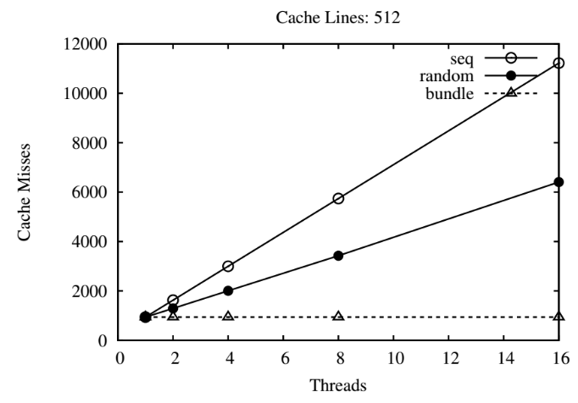
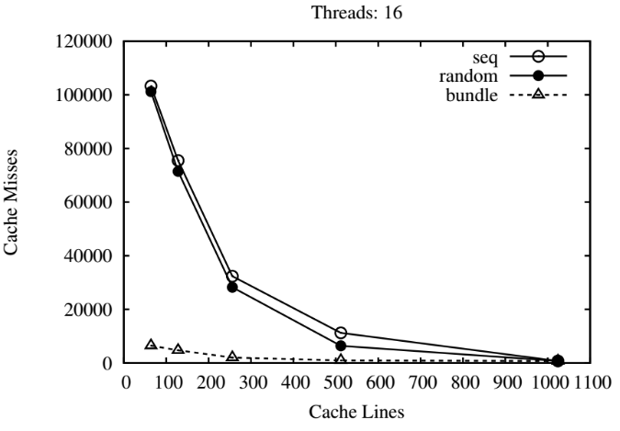
BUNDLE: Run-Time Evaluation
Notes:
The run-time results also favor BUNDLE’s approach. When compared to a serial scheduler, which executes threads one after another, and a random scheduler which introduces preemptions at pseudo-random intervals, the other schedulers increased their cache misses with the number of threads while BUNDLE stayed constant.
As the number of cache lines increases the benefit of BUNDLE decreases. With no benefit compared to any other scheduler when tasks fit entirely within the cache.

Slide 29
BUNDLE: Lessons
WCETO and run-time performance of BUNDLE affirms the potential inter-thread cache benefits.
An integrated approach of scheduling algorithm, WCETO calculation, and schedulability analysis is required.
BUNDLE is a promising first step.
Notes:
We learned from bundle that the positive perspective of caches has potential. We also learned that an integrated approach was required and we felt BUNDLE was a promising first step.

Slide 30
BUNDLE: First Step
Complex WCETO calculation.
WCETO analysis and run-time performance compared for synthetic, rather than real programs.
Sub-optimal cache sharing between threads due to scheduling decisions.
Notes:
After taking our first step with BUNDLE, we found some short comings of the original approach.
The WCET computation was overly complex.
The analysis and run-time evaluation was performed on mostly synthetic tasks, so it could not be applied to any real code base.
Most importantly, we found that cache sharing was sub-optimal due to scheduling decisions.

Slide 31
BUNDLE : Sub-Optimal Cache Sharing
Arbitrary active bundle selection creates complex WCETO calculations and sub-optimal cache sharing at run-time.
Notes:
The source of both sub-optimal cache sharing and complexity in the WCET analysis stems from the same root: arbitrary selection of which bundle to activate.

Slide 32
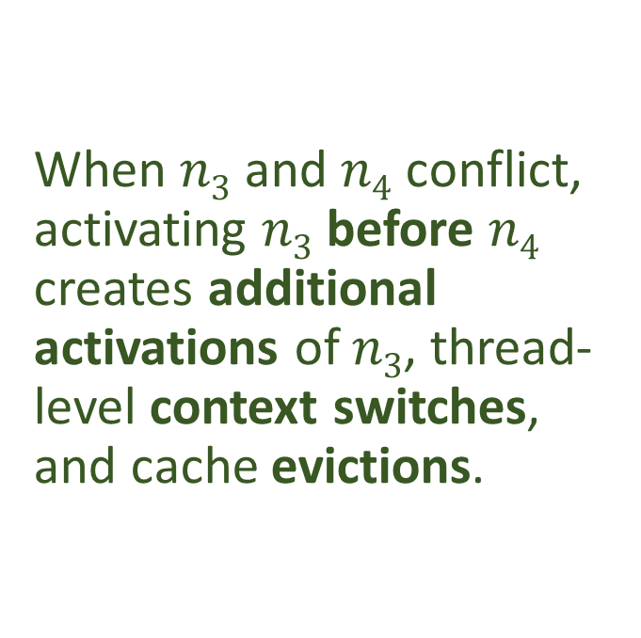




BUNDLE: Sub-Optimal Example
When $n3$ and $n4$ conflict, activating $n3$ before $n4$ creates additional activations of $n3$, thread-level context switches, and cache evictions.
$$n2$$
$$n1$$
$$n3$$
$$n4$$
Unnecessary
Execution Time
Notes:
To illustrate, consider this conflict free region graph and four threads CLICK
As the job is released, the first bundle activated is N1, followed by N2
At this point, BUNDLE could select either N3 or N4 as active.
CLICK In the worst case it would choose to activate N3
CLICK The only remaining choice is to activate N4 followed by N3
If we examine the graph and the timeline, we observe an unnecessary activation of N3.

Slide 33
BUNDLEP: Prioritize CFRs
Prioritizing CFRs produces optimal cache sharing.
Notes:
BUNDLEP addresses both problems of sub-optimal cache sharing and complex WCETO calculations the same solution:
Assigning priorities to conflict free regions which are inherited by bundles at run-time.

Slide 34




BUNDLEP: Priority by Path Length
Intuition informs priority assignment, the terminal CFR should have the worst priority.
$$n_{2}^{1}$$
$$n_{1}^{0}$$
$$n_{3}^{2}$$
$$n_{4}^{1}$$
Notes:
BUNDLEP assigns priorities to CFRs based on a simple observation. If the goal is to maximize cache sharing when all threads terminate, the terminal node of the CFRG should have the worst priority. Nodes immediately preceding the terminal node should have a slightly better, etcetera.
This is equivalent to assigning priorities to nodes based on their longest path length from the entry node.

Slide 35
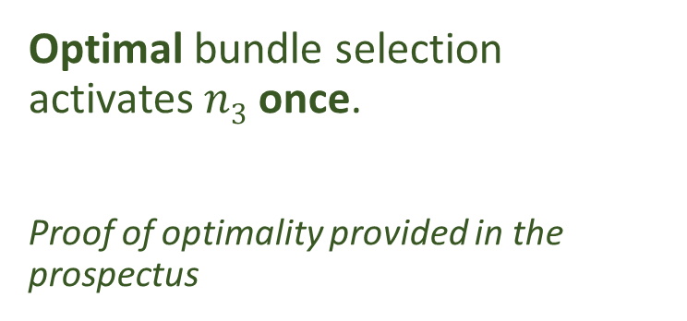
BUNDLEP: Optimal Example
$$n_{2}^{1}$$
Optimal bundle selection activates $n3$ once.
Proof of optimality provided in the prospectus
$$n_{1}^{0}$$
$$n_{3}^{2}$$
$$n_{4}^{1}$$
Savings
Execution Time
Notes:
CLICK Extending the earlier example and assigning priorities based on the length of the longest path from the entry node N1 BUNDLEP enters the same state as BUNDLE, with two threads waiting to execute N3 and two threads waiting to execute N4
CLICK Since N4 has a lesser priority it’s bundle is activated before N3 which saves one activation of N3 and optimizes cache sharing – proof of optimal cache-sharing can be found in the prospectus.

Slide 36


BUNDLEP: Directed Acyclic Graph
CFG
(is not a DAG)
Optimal assignment depends upon the CFRG being a DAG.
CFG Processing
CFR Creation
Loop Summary Nodes
$$h$$
$$z$$
Notes:
To provide optimal cache sharing via priority assignment, there is a small catch: the conflict free region graph must be a directed acyclic graph.
The control flow graph may contain cycles, it may also include ambiguity that could introduce cycles, which results in the conflict free region graph containing cycles.
BUNDLEP addresses these issues in three ways.
A novel method of construction for the control flow graph.
Careful conflict free region construction that avoids adding ambiguity.
And summary nodes to remove loops from the top level conflict free region graph
CLICK Control flow graph and conflict free region creation are implementation details which are better understood by reading the prospectus. For the presentation, we will focus on loop summary nodes.

Slide 37

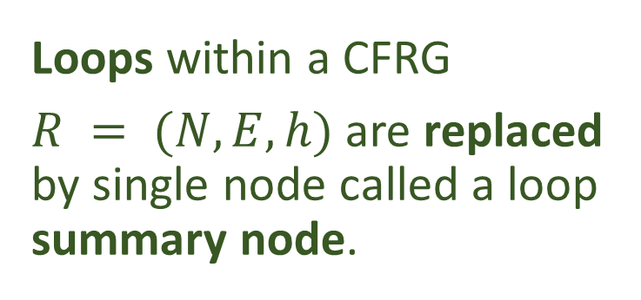








BUNDLEP: Loop Summary Nodes
Loops within a CFRG
$R = (N, E, h)$ are replaced by single node called a loop summary node.
$$n1$$
$$n2$$
$$h$$
$$n1$$
$$n3$$
$$n4$$
$$z$$
$$n5$$
$$n6$$
Notes:
When a loop is found within the conflict free region graph, CLICK
the loop head and all members of the loop are replaced with a single summary node.

Slide 38
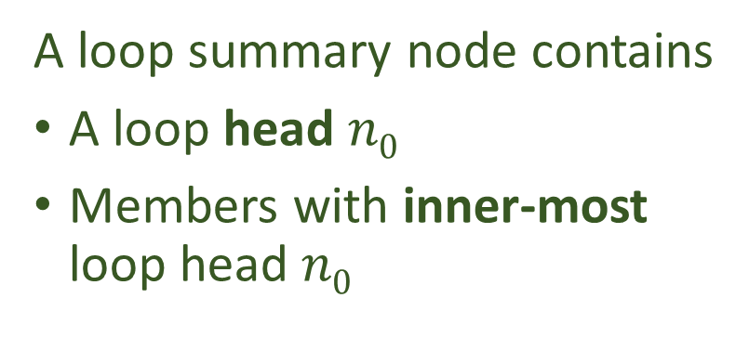




BUNDLEP: Loop Summary Node Structure
A loop summary node contains
A loop head $n0$
Members with inner-most loop head $n0$
$$n0$$
$$n1$$
Loop head
$$n3$$
$$n2$$
Notes:
Within a single loop summary node, the structure is restricted. The loop head must be present, which we call n0. All members of n0’s loop must be present in the summary node.
Within the summary node, only members with inner-most loop head n0 are permitted. The result of these restrictions is that each summary node contains exactly one cycle.

Slide 39










BUNDLEP: Loop Summary Node Structure
When loops are embedded, the inner-most loops are summarized first.
$$n9$$
$$n1$$
$$n2$$
$$n4$$
$$n5$$
$$n8$$
$$n3$$
$$n7$$
$$n6$$
$$n3$$
Notes:
Loops may be embedded within one another, which results in nodes have multiple loop heads. To ensure the single cycle requirement of summary nodes is met, CLICK the inner-most loops are summarized first CLICK

Slide 40

BUNDLEP: Loop Summary Node Structure
When loops are embedded, the inner-most loops are summarized first.
$$n9$$
$$n1$$
$$n1$$
$$n2$$
$$n8$$
$$n3$$
Notes:
When the outer summary node is summarize, the embedded summary nodes are treated identically to other nodes with the same inner most loop head.

Slide 41








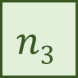







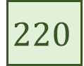







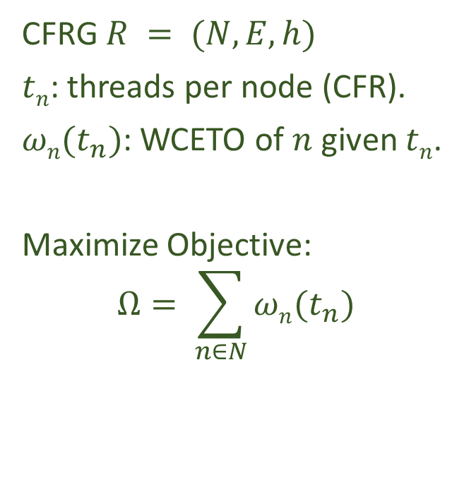


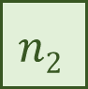



BUNDLEP: ILP Objective $Ω$
CFRG $R = (N, E, h)$
$tn$: threads per node (CFR).
$ωn(t_{n})$: WCETO of $n$ given $tn$.
Maximize Objective:
$$Ω= \sum_{n∈N}{ωn(t_{n}\text{)}}$$
$$n0$$
$$n1$$
$$n2$$
$$n3$$
$$n4$$
$n$₅
$$i$$
$$n0$$
$$n1$$
$$n2$$
$$n3$$
$$n4$$
$$n5$$
$$ti$$
$$4$$
$$4$$
$$2$$
$$4$$
$$2$$
$$2$$
$$Ω$$
$$ωi$$
$$40$$
$$20$$
$$70$$
$$30$$
$$50$$
$$10$$
$$220$$
Notes:
For worst case execution time analysis, restricting the conflict free region graph to a directed acyclic graph and assigning priorities to conflict free regions based on their longest path has two significant consequences.
First, the number of scheduling decisions are reduced, which subsequently reduces the number of paths that must be considered when calculating the WCET bound for a job.
Second, worst-case demand contributions are decomposed. For non-summary nodes, demand is determined by the number of threads assigned to the node and the structure of the control flow graph within it. For a summary node, the demand is determined by number of threads assigned to the summary node and the structure of the nodes within it.
These two factors allow the WCET calculation problem to be formulated as an integer linear program. The goal of the ILP is to maximize the contribution of individual nodes given a valid assignment of threads per node.
The constraints of the ILP limit the assignment of threads to nodes based on valid paths through the conflict free region graph. To ensure only valid paths are considered, threads are treated as flow on the incoming and outgoing edges of each node and that flow must be balanced. An individual node’s WCET is given by omega of t, where t is the number of threads executed on the node.
Do not say, hold for question: Variable growth O(N+E) for BUNDLEP, O((|N|!)^{m}) growth for BUNDLE

Slide 42

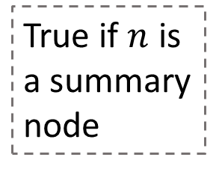
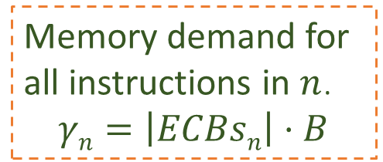
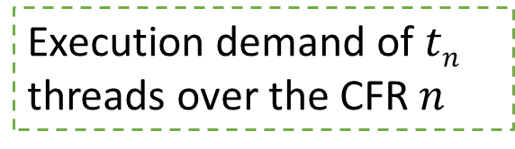
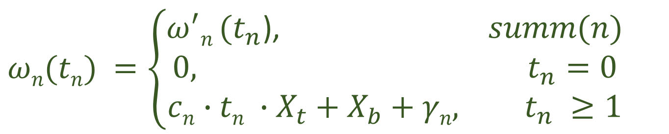
BUNDLEP: Node WCETO $ωn(t_{n}$)
$$ωn(tn) =\left\{\begin{aligned}ω^{′}n (t_{n}\text{)}\text{,} summ(n) \\ 0, t_{n}=0 \\ cn∙tn ∙X_{t}+X_{b}+γn, t_{n} \#≥1\end{aligned}\right.$$
True if $n$ is a summary node
Memory demand for all instructions in $n$.
$$γn=\left|ECBsn\right|⋅B$$
Execution demand of $tn$ threads over the CFR $n$
Context switch costs
Notes:
Skip this if you’re out of time
All worst case demand calculations leverage the system’s timing-compositional requirement, separating memory and execution demand.
CLICK For a non-summary node the execution demand is the WCET of a single thread over the conflict free region of the node assuming all instructions are present in the cache, multiplied by the number of threads assigned to the node.
CLICK The execution demand also includes the necessary context switch costs.
CLICK The node’s memory demand is the amount of time required to place all instructions of the conflict free region in the cache.
CLICK When the node is a summary node, omega prime is used to calculate the worst-case demand instead.

Slide 43

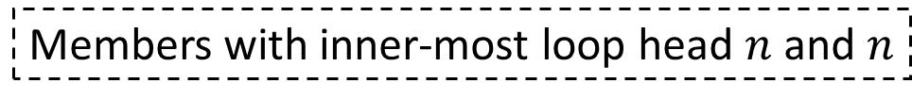
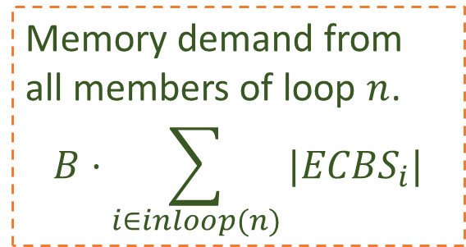
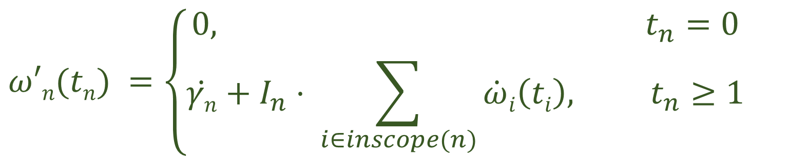
BUNDLEP: Summary Node WCETO $ω′n(t_{n}$)
$$ω′n(tn) =\left\{\begin{aligned}0, t_{n}=0 \\ \dot{γn}+I_{n}⋅ \sum_{i∈inscope(n)}{\dot{ω}i\left(ti\right), t_{n}≥1}\end{aligned}\right.$$
Memory demand from all members of loop $n$.
$$B⋅\sum_{i∈inloop(n)}{|{ECBS}_{i}|}$$
Per iteration execution and memory demand
Members with inner-most loop head $n$ and $n$
Notes:
For a summary node, CLICK the memory demand is sum of time required to cache all values of all nodes withinin the summary node.
CLICK CLICK the execution demand is the sum of all interior nodes per-iteration execution demand given by omega dot multiplied by the maximum number of iterations of the summary node given by I sub n.

Slide 44

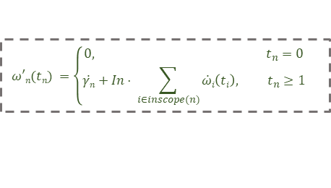
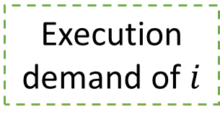
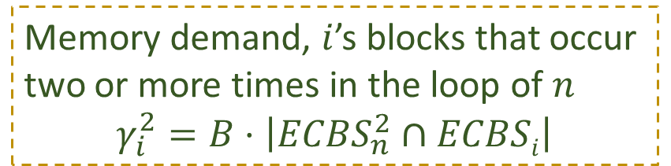
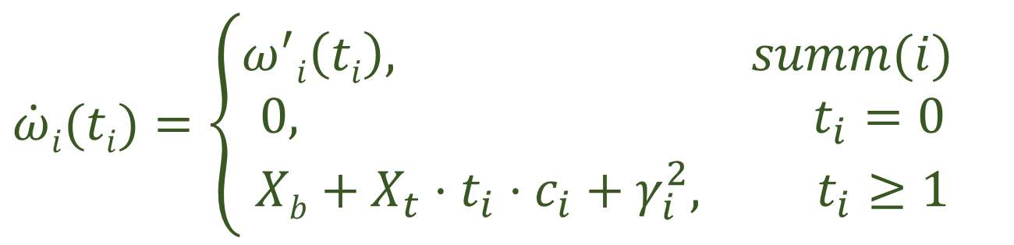
BUNDLEP: Per iteration Demand $\dot{ω}n(t_{n}$)
Recursive definition for embedded summary nodes
$$\dot{ω}i(ti)=\left\{\begin{aligned}ω^{′}i\left(ti\right), summ(i) \\ 0, t_{i}=0 \\ Xb+X_{t}⋅t_{i}⋅c_{i}+γ_{i}^{2}, t_{i}≥1\end{aligned}\right.$$
$$ω′n(tn) =\left\{\begin{aligned}0, t_{n}=0 \\ \dot{γn}+In⋅ \sum_{i∈inscope(n)}{\dot{ω}i\left(ti\right), t_{n}≥1}\end{aligned}\right.$$
Memory demand, $i$’s blocks that occur two or more times in the loop of $n$
$$γ_{i}^{2}=B⋅\left|{ECBS}_{n}^{2}∩ECBSi\right|$$
Context switch costs
Execution demand of $i$
Notes:
The per-iteration execution demand of a node given by omega dot, is similar to a node’s WCET given by omega CLICK
separating context switch costs, CLICK
execution demand, CLICK
and memory demand.
CLICK For embedded summary nodes, the per-iteration demand definition is taken recursively from the summary node’s WCET function, omega prime.

Slide 45
BUNDLEP: Hardware Mechanism
(Proposed)
Notes:
BUNDLEP’s scheduling decisions, like BUNDLE’s, rely upon the concept of anticipating execution
Detecting when a thread leaves one region and enters another depends on the instruction the thread will execute.
Currently, we know of no hardware mechanism that supports anticipation.
In BUNDLE we gave a brief description of a mechanism, in BUNDLEP we provide a concrete definition that behaves very similarly to hardware-based break points or watch points. This mechanism was designed for BUNDLEP but is perfectly suitable for BUNDLE.

Slide 46

BUNDLEP: Hardware Mechanism
$$n1$$
$$n2$$
$$X$$
Two Parts
An XFLICT interrupt.
An XFLICT_TABLE of addresses to raise the conflict for.
$$h$$
$$n3$$
$$n4$$
$$z$$
$$n5$$
$$n6$$
Notes:
The interrupt mechanism is divided into two parts.
The conflict interrupt itself, which indicates that a possible conflict would occur if the instruction were executed. The conflict carries ancillary data indicating the instruction which elicited the interrupt.
The conflict table, managed by the scheduling algorithm, which contains the addresses of upcoming possible conflicts.

Slide 47



BUNDLEP: Hardware Mechanism
XFLICT
Before activating a CFR, BUNDLEP populates the XFLICT_TABLE with the entry instructions of subsequent CFRs
When a thread attempts to execute an instruction with an address in the table, it is halted before executing the instruction and an XFLICT interrupt is raised.
$$n1$$
$$n2$$
$$X$$
$$n1$$
$$n5$$
$$h$$
$$n3$$
$$n4$$
$$z$$
$$n5$$
$$n6$$
Notes:
Before activation of a bundle, BUNDLEP examines the immediate successors of the active CFR. CLICK
It places the addresses of the entry nodes of the successors in the conflict table. CLICK
When a thread attempts to execute any of the instructions in the table, the thread is blocked, and the conflict interrupt is raised.
CLICK In response to the interrupt being raised, BUNDLEP moves the thread into the new inactive bundle CLICK
After clearing the interrupt, BUNDLEP resumes one of the blocked threads waiting to execute in the active bundle
The process repeats until all threads have left the active bundle and are blocked waiting for their new bundle to be activated.

Slide 48

BUNDLEP: Hardware Mechanism
XFLICT
Before selecting the next active bundle, BUNDLEP clears the XFLICT_TABLE.
The process repeats until all threads terminate.
$$n1$$
$$n2$$
$$X$$
$$n6$$
$$h$$
$$n3$$
$$n4$$
$$z$$
$$n5$$
$$n6$$
Notes:
The last operation related to the conflict table occurs when the active BUNDLE is depleted.
CLICK Before selecting a new active bundle, the conflict table is cleared.
With a clear conflict table a new bundle is selected as active. The scheduling process of activated and depleting bundles repeats until all threads terminate.

Slide 49

BUNDLEP: Evaluation
Analysis and simulation, available online http://www.cs.wayne.edu/~fh3227/bundlep
Notes:
A significant contribution of BUNDLEP is the simulation and evaluation platform.
It is available online for modification and reuse by other groups interested in our work.

Slide 50
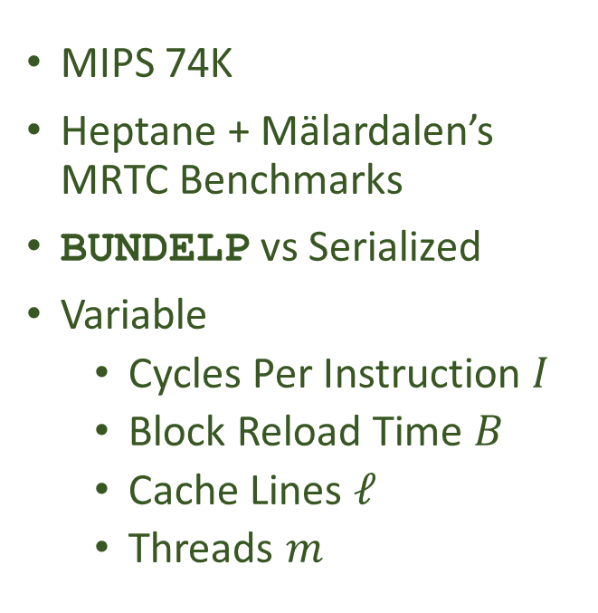
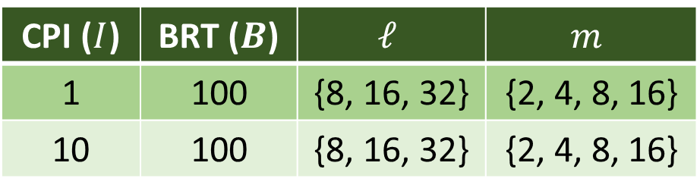
BUNDLEP: Target
MIPS 74K
Heptane + Mälardalen’s MRTC Benchmarks
BUNDELP vs Serialized
Variable
Cycles Per Instruction $I$
Block Reload Time $B$
Cache Lines $ℓ$
Threads $m$
CPI ($I$) | BRT ($B$) | $$ℓ$$ | $$m$$
1 | 100 | {8, 16, 32} | {2, 4, 8, 16}
10 | 100 | {8, 16, 32} | {2, 4, 8, 16}
Notes:
The evaluation was based upon the Heptane toolset developed an Inria, which includes native support for the MRTC benchmarks.
We compared BUNDLEP’s analysis and run-time performance to Heptane’s bounds and a serial scheduler.
Our target was a MIPS 74K processor with a variable number of cache lines, block reload time, and cycles per instruction. The analysis and simulation varied m, the number of threads released with each job.

Slide 51
BUNDLEP: Representative Results
Complete results are available as a technical report at
https://arxiv.org/abs/1805.12041
Notes:
The full results for the MRTC benchmarks are available online at archive.org. Here, and in the prospectus, we focus on the summary performance and the information gained from the evaluation.

Slide 52
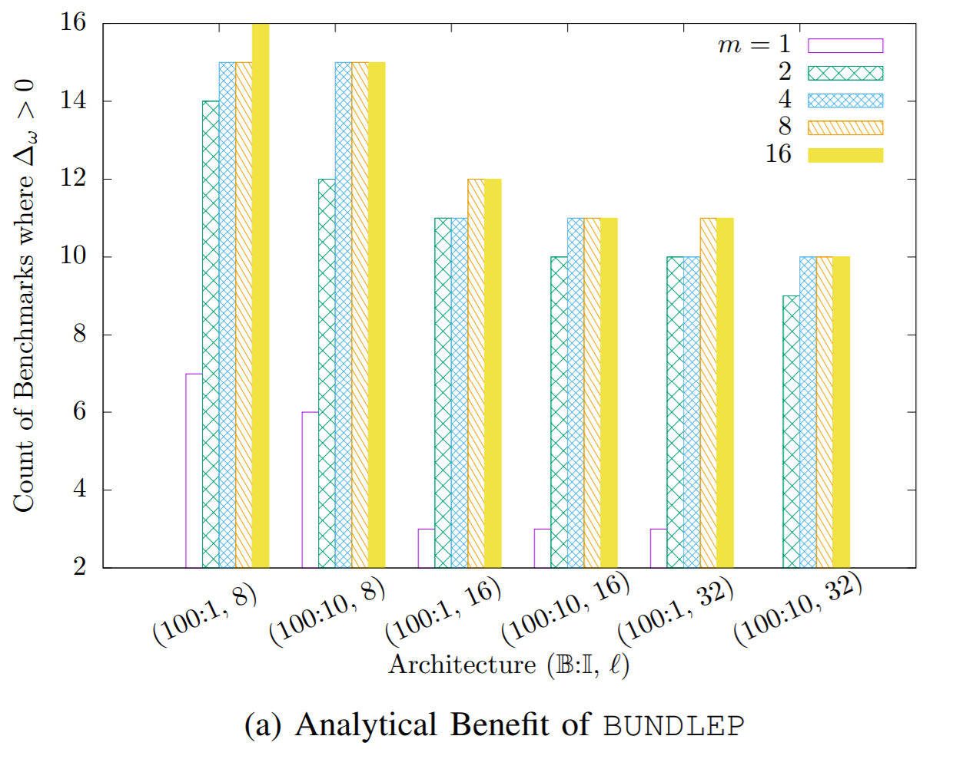
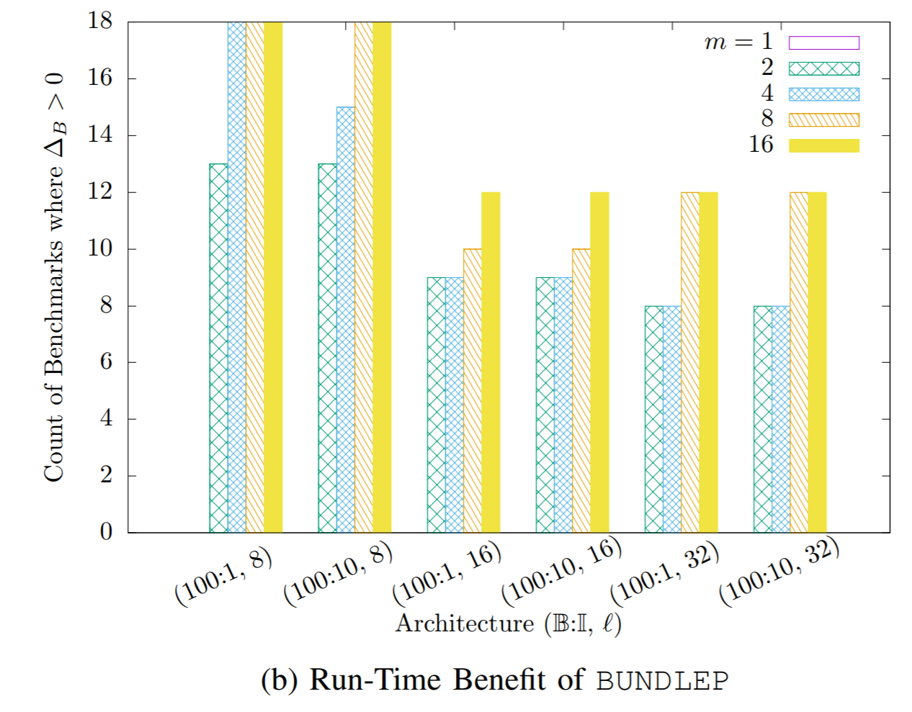
BUNDLEP: Evaluation Summary
Notes:
In general, BUNDLEP provides an analytical benefit in terms of WCET values. The graph on the left quantifies the benefit of BUNDLEP analysis over Heptane’s serial WCET bound. The y-axis is the count of benchmarks where BUNDLEP produced a lower WCET bound. Each group of histograms represent a specific architecture configuration, enumerated by their block reload time, cycles per instruction, and number of cache lines. The first group represents an architecture with a block reload time of 100 cycles, one cycle per instruction, for 8 cache lines. Within the group, the number of tasks that benefit from BUNDLEP varies by the number of threads per job. BUNDLEP produces a lower bound for 13, 15, and 16 of the benchmarks as the number of threads increase from 2, to 4, to 8, and then 16. In the worst configuration, BUNLDEP produces a WCET value smaller than Heptane for half of the benchmarks.
The graph on the right summarizes the run-time benefit of BUNDLEP compared to a serialized scheduler. It is organized in the same manner as the graph on the left, a group for one set of architecture parameters, for an increasing number of threads. In the worst configuration, BUNDLEP provides a run-time benefit with a lower total execution time for almost half of the benchmarks. In the best architecture configuration BUNDLEP outperforms serialized execution for all of the benchmarks.
There are three trends that we notice in the summarized performance. When the number of threads increase the benefit from BUNDLEP analysis and scheduling increases. When the cache size increases the number of tasks that benefit decreases. When the block reload time increases more quickly than the cycles per instruction, BUNDLEP’s benefit also increases.

Slide 53
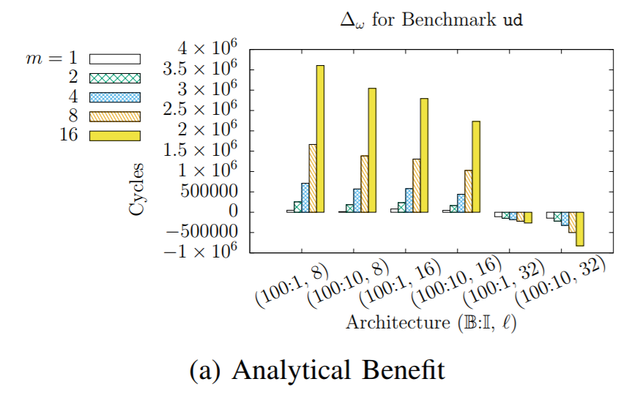

BUNDLEP: Expected Performance
Notes:
The ud benchmark is a representative of other benchmarks that benefited from BUNDLEP analysis and scheduling.
The graph on the left represents the analytical benefit of BUNDLEP over Heptane. It follows the same organizational structure as the summary information on the previous slide, except that the y-axis is cycles saved rather than the count of benchmarks.
The trend of BUNDLEP’s increasing benefit as the number of threads increases is seen in each group.
The trend of BUNDLEP’s benefit decreasing as the cache size grows until reaching 32 lines is seen across all groups.
The graph on the right represents the run-time benefit of BUNDLEP, following the same organization as the analytical benefit. It illustrates, again, the decreasing performance of BUNDLEP as the cache size grows, and in some cases taking longer to complete than the serial scheduler.

Slide 54


BUNDLEP: Anomalies
Context Switches Consume Time
Notes:
For some benchmarks BUNDLEP analysis and run-time performance is worse than serialized execution. The matmult benchmark is one such example.
On the left, in the analysis, we see as the number of threads increase BUNDLEP’s performance decreases.
On the right, the run-time performance is inconsistent but generally favors serialized execution.
The cause of the analytical and run-time deficit in BUNDLEP’s performance is directly related to small conflict free regions. CLICK
Unlike the analysis of BUNDLE, BUNDLEP does not assume that context switches take zero time. Context switches are included in both the analysis and run-time evaluation. For the benchmarks where BUNDLEP performs poorly, conflict free regions are small. Where the inter-thread cache benefit is less than the context switch time. This degrades performance, which leads to the results we see for the matmult benchmark and others.
We have identified the cause as small conflict free regions compared to the inter-thread cache benefit and context switch costs. This presents an opportunity for us to relax our strict definition of conflict free regions, or adjust our scheduling decisions to benefit more tasks via BUNDLEP’s approach.

Slide 55
BUNDLEP: Lessons
Further support for the positive perspective of caches to hard real-time multi-threaded tasks.
Practical evaluation platform provides insights into areas where BUNDLEP’s approach can be improved.
Support for a familiar and feasible hardware mechanism.
Notes:
Taking the evaluation into consideration what we find is further support for the positive perspective of caches when applied to compiled programs.
These results also highlight areas of BUNDLEP that need improvement, particularly surrounding small conflict free regions.
And lastly, support for BUNDLEP in real hardware seems feasible given that the conflict interrupt is remarkably similar to hardware interrupts used in debugging.

Slide 56
Further Opportunities
Improvements
Advancement
Non-Preemptive Multi-Task
Conditional thread-level context switches for bundles
From ILP to Polynomial WCETO Calculation
Optimally Sized CFR Calculation
RISCV
Fully Preemptive Multi-Task
Physical Prototype
Hierarchical Caches
Associative Caches
Replacement Policies
Multi-Core
Data Caches
Notes:
Results from BUNDLE and BUNDLEP are encouraging. Exploring the positive approach to caches, we’ve discovered more opportunities to improve upon and advance them.
Of paramount importance to us, is to increase the scope from a single multi-threaded task to a multi-threaded multi-task set, with non-preemptive scheduling as the first step. The results of which will inform the schedulability analysis for a fully preemptive multi-task version of BUNDLEP.
The immediate improvements available for BUNDLEP focus on its deficiencies and the evaluation platform. CFRs with small inter-thread cache benefits can be counter-balanced by selectively allowing threads to continue execution through those CFRs without blocking. In BUNDLEP, the complexity of WCETO was addressed with an ILP. Though we think there is an alternative to formulating BUNDLEP’s WCETO problem, we have yet been unable to find it. Further research may yield a greedy approach, or another with lesser complexity. Lastly, with the introduction of RISCV as an open source processor, shifting the evaluation target to RISCV and to one of the many available simulators would bring a greater benefit to others interested in our work.
To advance the positive perspective, begins with limited and fully preemptive multi-task sets. From there, a physical prototype seems straight forward to construct. Followed by the use of hierarchical caches, and associative caches with different replacement policies. Multi-core analysis would also increase acceptance and adoption. Data caches are on the distant horizon requiring a different approach.

Slide 57
Dissertation Timeline
Working Title | Venue | Effort | Submission Date | Publication Date
EN-BUNDLE: Non-Preemptive Multi-Threaded Multi-Task Cache Sharing | ECRTS 2019 | 2 Months | February 2019 | April 2019
Balancing Cache Reuse and Context Switches in BUNDLEP | EMSOFT 2019 | 2 Months | March 2019 | September 2019
BUNDLE-S: Cache Reuse via Preemptive BUNDLEP Scheduling | RTSS 2019 | 3 Months | May 2019 | December 2019
Dissertation Defense | Wayne State University | 2 Months | June 2019
Notes:
For the dissertation, we intend to address three of the opportunities, before a defense in June.
For ECRTS in February, we want to bring BUNDLEP from one multi-threaded task to multiple tasks using non-preemptive scheduling.
For EMSOFT in March, we plan to improve BUNDLEP’s single task performance by adding flexibility in BUNDLEP’s scheduling decisions.
Lastly, for RTSS in May, we will bring limited and fully preemptive multi-threaded multi-task scheduling to BUNDLEP including the impact of cache related preemption delay.

Slide 58
Publications
Corey Tessler, Nathan Fisher. BUNDLEP: Prioritizing Conflict Free Regions in MultiThreaded Programs to Improve Cache Reuse, Proceedings of IEEE Real-Time Systems Symposium (RTSS), Nashville, Tennessee, 2018.
Corey Tessler, Gedare Bloom, Nathan Fisher. Work-in-Progress: Reducing Cache Conflicts via Interrupts and BUNDLE Scheduling, Proceedings of IEEE Real-Time and Embedded Technology and Applications Symposium (RTAS), Vienna, Austria, 2017.
Corey Tessler, Nathan Fisher. BUNDLE: Real-Time Multi-Threaded Scheduling to Reduce Cache Contention, Proceedings of IEEE Real-Time Systems Symposium (RTSS), Porto, Portugal, 2016.
John Cavicchio, Corey Tessler, Nathan Fisher. Minimizing Cache Overhead via Loaded Cache Blocks and Preemption Placement, Proceedings of Euromicro Conference on Real-Time Systems (ECRTS), Lund, Sweden, 2015.
Notes:
Thank you for your time, I would like to invite your questions now! Thank you.

